Slide 1
Greening curriculum guidance
Teaching and learning for climate action
Notes:
As part of UNESCO’s contribution to GEP’s Working Group 1 on Greening Schools, we have developed the Green School Quality Standard.

Slide 2
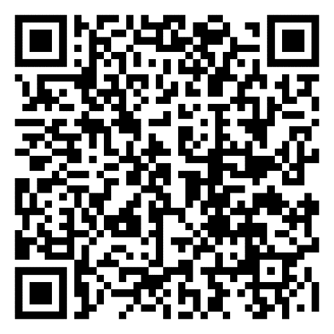

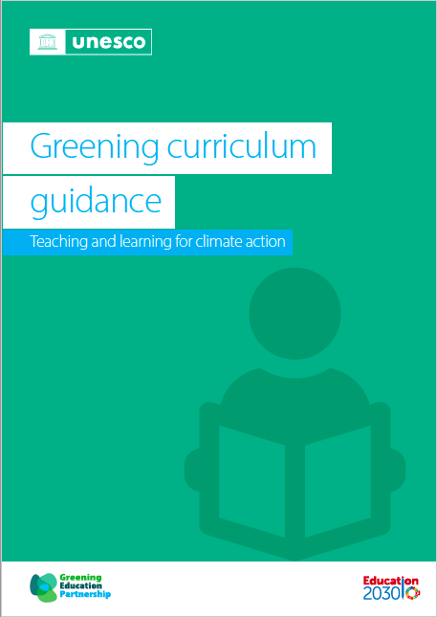
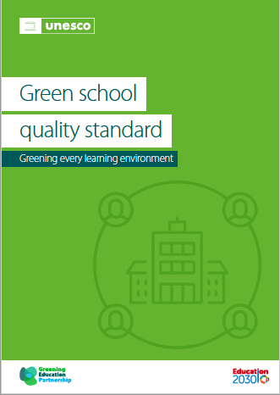
Greening Education Partnership: 2 new resources
What does quality climate change education look like?
🡺 The two technical guidance documents that define a common language of greening education
Greening curriculum guidance - how to integrate climate change and sustainability issues into the curriculum.
Green school quality standard – establishes quality standards for green schools
Notes:
Technical Guidance Documents on Greening Education
To transform our education systems, it is critical that we first define what we mean by greening education. Until now, we haven’t had a clear definition of what quality climate change education in this area truly means, in the way that young people demand today.
This is why through the Greening Education Partnership, UNESCO has developed two technical guidance documents that define a common language of greening education.
The first document establishes quality standards for green schools and the other advises how to integrate climate change and sustainability issues into the curriculum. The green school quality standard is being developed through the Working Group on Greening Schools, while the Green School Quality Standard is being developed through the Working Group on Greening Curriculum.
We hope that you join us in this collective journey to take forward these two crucial documents to ensure they inform current practices and help transform education to get every learner climate-ready.
Thank you again for being with us today and I hope you enjoy the rest of the webinar.
I will now pass the floor to my colleague Jun Morohashi to go deeper into the technical details of the documents.

Slide 3
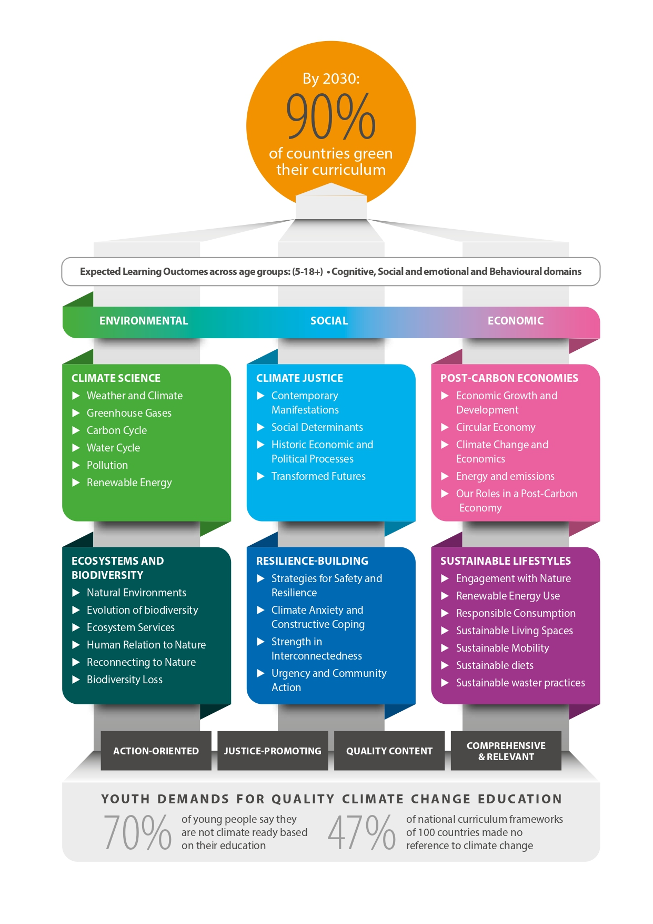
Greening curriculum guidance
70% of of young people say the aren’t climate ready based on their education and 47% of curriculum frameworks in 100 countries don’t mention climate change
The Greening Curriculum Guidance:
Supports countries to integrate climate change education into curriculum.
Uses a holistic approach to education for sustainable development, considering social, economic, and environmental issues.
Provides expected learning outcomes of learners on climate change education across different age groups and topics.
Addresses the cognitive, socio-emotional and behavioural domains, with a particular emphasis on action.
The goal: By 2030, 90% of countries have ‘greened’ their curriculum
Notes:
Greening Curriculum Guidance
Let us move to the Greening Curriculum Guidance, which is a global technical guidance on climate change in curriculum in response to young people’s calls for a more holistic and action-oriented approach to climate change education.
The Guidance follows a holistic approach to education for sustainable development, considering social, economic, and environmental issues, and is structured around various key concepts.
It establishes expected learning outcomes per age group from 5-years to 18+ including lifelong learning
The expected learning outcomes address the cognitive, socio-emotional and behavioural domains, with an emphasis on action. So it is not just about knowing about climate change with our heads, but sharing the values in our hearts, and taking action with our hands.
And the goal is for all of us to work together towards reaching the target of doubling the percentage of countries that have climate change in their curriculum from appx. 45% today to 90% by 2030.

Slide 4
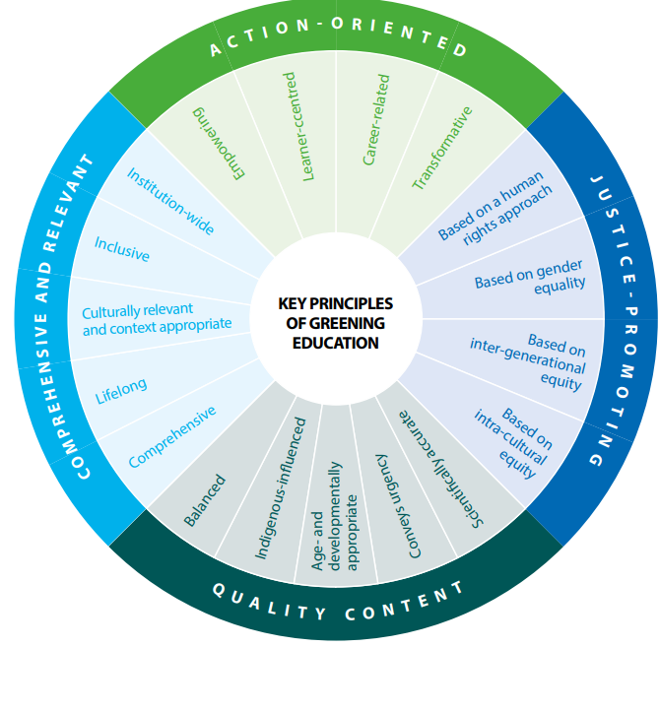
Greening curriculum guidance: principles and strategies
These are the key principles for the design and delivery of greening education in formal, non-formal and informal settings:
Action-oriented
Justice-promoting
Quality content
Comprehensive and relevant

Slide 5
Greening curriculum guidance: principles and strategies
Strategies for getting every learner climate ready
WHAT TO LEARN
HOW TO LEARN
WHERE TO LEARN
Address cognitive, social-emotional learning and taking action
Contextualized, emphasizing the relevance of local knowledge
Learner-centred, experiential and reflective
Integrated approach
Holistic assessment
Schools through a whole institution approach
Communities through public awareness campaigns
Nature-based museums and UNESCO-designated sites
Youth-created social movements
Notes:
The Guidance aims to be a foundational tool for greening education.
It is not a curriculum in itself but is aimed at serving as the basis for a review of existing curricula and the integration of climate change across all subjects including the social sciences, natural sciences, humanities and technical education
The following principles underpin the design and delivery of greening education in formal, non-formal and informal settings.
It also provides key recommendations and guidance on how to implement these principles in a holistic manner in a curriculum. It answers questions raised by young people in their demands
such as:
What should we learn to get climate-ready?
How can a curriculum address cognitive, social and emotional learning dimensions with a focus on taking action, rather than the current status where climate change is in sciences and biased towards cognitive knowledge?
How can a curriculum be contextualized for various contexts in addressing the climate crisis based on the local conditions?
b) How should we learn to get climate-ready?
How can a curriculum shift to be learner-centred, experiential, and reflective for learners to be active rather than passive actors in the climate crisis?
How can a curriculum integrate diverse aspects of climate change in various subjects – including relatively newer areas such as climate justice, and post-carbon economies?
Given this holistic approach of addressing all domains -cognitive, social and emotional, and behavioural learning – how can assessment be rethought to ensure that it not only concentrates on the cognitive domain?
c) Where should we learn to get climate-ready
How can we transform learning environments to be effective in taking action in the climate crisis?
How can other informal and non-formal learning spaces such as communities, cities, and families be transformed for lifelong learning opportunities?

Slide 6
Greening curriculum guidance: structure and content
Example:
Concept
Concept 1: Climate science
Topic
Topic 1.4 – The water cycle
Key Idea
Key Idea: Water is important for humans, animals and plants
Under 5 year*
Expected learning outcomes
5-8 years
Learners will be able to:
5-8 years
9-12 years
13-15 years
Cognitive
Social and emotional
Behavioral
Cognitive
Social and emotional
Behavioral
16-18 years
18+ years
- explain that water makes up over half of the body and we need it daily
- Develop problem solving skills and care through a water-related story
Watering plans
Conserve water by turning off taps
* For Early Childhood (under 5 years old), fostering a love for nature can be promoted through play and a positive, solutions-focused approach provided in the guide for 5-8 year-olds.
Notes:
For Early Childhood (under 5 years old), fostering a love for nature can be promoted through play and a positive, solutions-focused approach provided in the guide for 5-8 year-olds.

Slide 7
Greening curriculum guidance: 6 key concepts
Environmental
Social
Economic
CLIMATE SCIENCE
▶ Weather and Climate
▶ Greenhouse Gases
▶ Carbon Cycle
▶ Water Cycle
▶ Pollution
▶ Renewable Energy
CLIMATE JUSTICE
▶ Contemporary Manifestations
▶ Social Determinants
▶ Historic Economic and Political Processes
▶ Transformed Futures
POST-CARBON ECONOMIES
▶ Economic Growth and Development
▶ Circular Economy
▶ Climate Change and Economics
▶ Energy and Emissions
▶ Our Roles in a Post-Carbon Economy
ECOSYSTEMS AND BIODIVERSITY
▶ Natural Environments
▶ Evolution of Biodiversity
▶ Ecosystem Services
▶ Human Relation to Nature
▶ Reconnecting to Nature
▶ Biodiversity Loss
RESILIENCE-BUILDING
▶ Strategies for Safety and Resilience
▶ Climate Anxiety and Constructive Coping
▶ Strength in Interconnectedness
▶ Urgency and Community Action
SUSTAINABLE LIFESTYLES
▶ Engagement with Nature
▶ Renewable Energy Use
▶ Responsible Consumption
▶ Sustainable Living Spaces
▶ Sustainable Mobility
▶ Sustainable Diets
▶ Sustainable Waste Practices

Slide 8
Examples of learning outcomes
Topic 4.3. Climate anxiety and constructive coping
 | Cognitive | Social and emotional | Behavioral
16-18 years | KEY IDEA: Climate anxiety presents an opportunity to better understand and manage our emotions.
 | Learners should be able to: ▶ describe the concept of climate anxiety, its causes, manifestations, and the reasons it has become prevalent among their age group. ▶ distinguish between various emotions related to climate concerns, such as grief, anger, fear, and guilt, and understand the potential sources of these feelings. | Learners should be able to: ▶ foster empathy towards themselves and others experiencing climate anxiety and recognize the value of shared experiences in navigating challenging emotions. ▶ demonstrate a sense of hope and understanding that while the challenges posed by climate change are significant, collective action and individual contributions can make a difference. | Learners should be able to: ▶ demonstrate skills to recognize and manage their emotions related to climate change, such as exploring local solutions to combat heatwaves through online research, ensuring they don’t become overwhelming or paralysing. ▶ Express their feelings through creative activities such as journaling emotions or debating about how climate anxiety can arise and ways to manage these emotions effectively. ▶ Participate in community events or initiatives that raise awareness about climate anxiety and promote mental health support.

Slide 9










How to integrate into the curriculum
Review existing curriculum
Finalize and distribute resources
Inclusive curriculum development
Prepare textbook writers and examiners
Decide on strategies
Train teachers
Develop detailed curriculum
Adopt WIA and partnerships
Prepare and pilot sample resources
Monitor and assess results
Notes:
Planners may wish to anticipate the following steps in designing, implementing and improving efforts to
integrate learning outcomes into the curriculum:
Step 1. Review existing education policies for footholds and rationales for strengthening the presence of
greening education in the curriculum.
● Step 2. Establish and ensure inclusive participation of stakeholders in the curriculum development process,
including youth and community members.
● Step 3. Decide on curricular strategies for infusing greening education within and across subjects and grade
levels in schools, as well as recommendations for the non-formal education sector.
● Step 4. Develop a detailed curriculum that ensures action-oriented learner outcomes, including the use of
transformative and ‘place-based’ pedagogy.
● Step 5. Prepare and pilot sample instructional resources within and across subject areas to test the new
curriculum and solicit feedback from numerous stakeholders, especially youth.
● Step 6. Finalize, produce and distribute learning resources, including suggestions for assessment, with an
associated communication and publicity strategy.
● Step 7. Provide substantive orientation to greening education for textbook writers, examination board staff
and other stakeholders, and obtain any necessary approvals.
● Step 8. Provide educators with quality pre- and in-service training and continuous professional development
opportunities, in cooperation with higher education institutions and CSOs.
● Step 9. Implement the Guidance through whole institution approaches and strengthen partnerships
between schools, CSOs, municipal authorities and the private sector to implement greening education.
● Step 10. Monitor and assess the results of education programming on climate change competencies in an
ongoing manner.

Slide 10
Step 3 - Examples of interdisciplinary curriculum strategies
5-8 years
 | Learning outcomes | Subjects
Climate Science | Topic 1.1 Generalize regular weather patterns as seasons and 'climate.' | Social/environmental studies class or language class: Ask learners to observe and describe daily weather (e.g. temperature, rain, wind) in their locality, and relate this to weather over the previous 12 months in terms of 'seasons,' through artwork, writing or drama. Develop a class activity to record what older people say about past weather patterns and consolidate the concept of 'climate'.
Ecosystem & Biodiversity | Topic 2.2 Advocate for the memory of recently extinct species. | Art class: As a school community, create representations of extinct or nearly extinct local animals and create a festival to celebrate them.
Climate Justice | Topic 4.4 Appreciate indigenous practices and relationships with the land | Music class: Ask learners to listen to and learn the lyrics and the meaning behind an indigenous song about the land.
Resilience- Building | Topic 3.2 Appreciate the importance of safety during extreme weather events or climate disasters. | Health class: Ask learners to develop a list of actions they would take in different extreme weather events and discuss skills such as listening to adults, following rules, and working to help in a potential emergency.
Post-Carbon Economies | Topic 5.1 Explain the resources needed in those examples of growth. | Art class: Organize an artwork competition with the theme of 'growth and resource' with an embedded session on the discussion of each piece of artwork from the perspective of the relation between growth and resource.
Sustainable Lifestyles | Topic 6.7 Explain what upcycling aims for and how it functions. | Art class: Work with learners to collect used or unwanted materials; create a list of the items that may be used in their designs; design a space where they can work; and help them recreate new items from those materials and recognize their own artistic capabilities for creative use of waste.
Notes:
Step 3. Decide on curricular strategies for
infusing greening education within and
across subjects and grade levels in schools, as
well as recommendations for the non-formal
education sector.
Teachers may wish to integrate learning outcomes into various subjects beyond science and geography classes – into arts, music, health, language classes across subjects.

Slide 11
Next steps for GEP Members and beyond
Disseminate the Guidance to ensure that Ministries and key partners are familiar with the content
Organise capacity-building activities so that its content is understood and adopted
Integrate the key elements and principles into your respective curricula, pedagogy and teacher training
Identify and share key existing resources and successful practices and work with partners to create new ones
Monitor its uptake and the alignment of existing curricula to this new global standard
Notes:
Greening Curriculum Guidance
And the goal is for all of us to work together towards reaching the target of doubling the percentage of countries that have climate change in their curriculum from appx. 45% today to 90% by 2030.

Slide 12
Thank you!
For more information - gep@unesco.org

